Slide 1
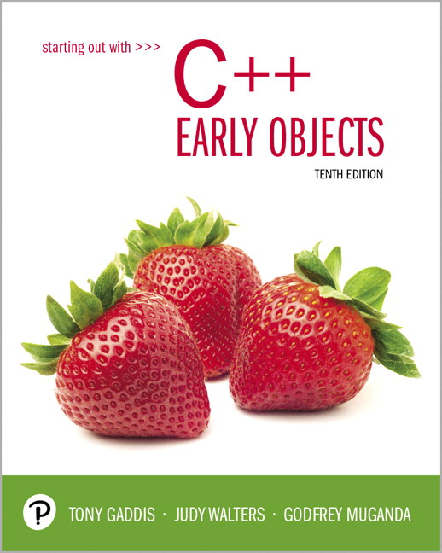
Starting Out with C++ Early Objects
Tenth Edition
Chapter 5
Looping

Slide 2
Topics 1 of 2
5.1 Introduction to Loops: The while Loop
5.2 Using the while loop for Input Validation
5.3 The Increment and Decrement Operators
5.4 Counters
5.5 Keeping a Running Total
5.6 Sentinels

Slide 3
Topics 2 of 2
5.7 The do-while loop
5.8 The for loop
5.9 Deciding Which Loop to Use
5.10 Nested Loops
5.11 Breaking Out of a Loop
5.12 Using Files for Data Storage
5.13 Creating Good Test Data

Slide 4
5.1 Introduction to Loops: The while Loop
Loop: a part of a program that may execute > 1 time (i.e., it repeats)
while loop format:
while (condition)
{ statement(s);
}
The {} can be omitted if there is only one statement in the body of the loop

Slide 5
How the while Loop Works
while (condition)
{ statement(s);
}
condition is evaluated
if it is true, the statement(s) are executed, and then condition is evaluated again
if it is false, the loop is exited
An iteration is an execution of the loop body

Slide 6
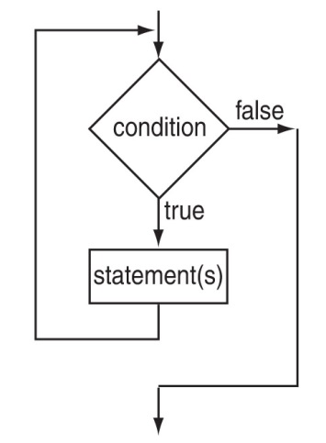
while Loop Flow of Control

Slide 7
while Loop Example
int val = 5;
while (val >= 0)
{ cout << val << " ";
val = val - 1;
}
produces output:
5 4 3 2 1 0
val is called a loop control variable
Notes:
See pr5-01.cpp

Slide 8
while Loop Is a Pretest Loop
while is a pretest loop (the condition is evaluated before the loop executes)
If the condition is initially false, the statement(s) in the body of the loop are never executed
If the condition is initially true, the statement(s) in the body will continue to be executed until the condition becomes false

Slide 9
Exiting the Loop
The loop must contain code to allow the condition to eventually become false so the loop can be exited
Otherwise, you have an infinite loop (i.e., a loop that does not stop)
Example infinite loop:
x = 5;
while (x > 0) // infinite loop because
cout << x; // x is always > 0

Slide 10
Common Loop Errors
Don’t put ; immediately after (condition)
Don’t forget the { } :
int numEntries = 1;
while (numEntries <=3)
cout << "Still working … ";
numEntries++; // not in the loop body
Don’t use = when you mean to use ==
while (numEntries = 3) // always true
{
cout << "Still working … ";
numEntries++;
}

Slide 11
while Loop Programming Style
Loop body statements should be indented
Align { and } with the loop header and place them on lines by themselves
Note: The conventions above make the source code more understandable by someone who is reading it. They have no effect on how the source code compiles or how the program executes.
Notes:
See pr5-02.cpp

Slide 12
5.2 Using the while Loop for Input Validation
Loops are an appropriate structure for
validating user input data
Prompt for and read in the data.
Use a while loop to test if data is valid.
Enter the loop only if data is not valid.
In the loop body, display an error message and prompt the user to re-enter the data.
The loop will not be exited until the user enters valid data.
Notes:
See pr5-03.cpp

Slide 13
Input Validation Loop Example
cout << "Enter a number (1-100) and"
<< " I will guess it. ";
cin >> number;
while ((number < 1) || (number > 100))
{ cout << "Number must be between 1 and 100."
<< " Re-enter your number. ";
cin >> number;
}
// Code to use the valid number follows

Slide 14
5.3 The Increment and Decrement Operators
Increment – increase the value in variable
++ adds one to a variable
val++; is the same as val = val + 1;
Decrement – reduce the value in variable
-- subtracts one from a variable
val--; is the same as val = val – 1;
can be used in prefix mode (before) or
postfix mode (after) a variable
Notes:
See pr5-04.cpp

Slide 15
Prefix Mode
++val and --val increment or decrement the variable, then return the new value of the variable.
It is this returned new value of the variable that is used in any other operations within the same statement

Slide 16
Prefix Mode Example
int x = 1, y = 1;
x = ++y; // y is incremented to 2,
// then 2 is assigned to x
cout << x
<< " " << y; // Displays 2 2
x = --y; // y is decremented to 1,
// then 1 is assigned to x
cout << x
<< " " << y; // Displays 1 1

Slide 17
Postfix Mode
val++ and val-- return the current value of the variable, then increment or decrement the variable
It is this returned current value of the variable that is used in any other operations within the same statement

Slide 18
Postfix Mode Example
int x = 1, y = 1;
x = y++; // y++ returns a 1
// The 1 is assigned to x
// and y is incremented to 2
cout << x
<< " " << y; // Displays 1 2
x = y--; // y-- returns a 2
// The 2 is assigned to x
// and y is decremented to 1
cout << x
<< " " << y; // Displays 2 1
Notes:
See pr5-05.cpp

Slide 19
Increment & Decrement Notes
They can be used in arithmetic expressions
result = num1++ + --num2;
They must be applied to a variable, not an expression or a literal value. You cannot have
result = (num1 + num2)++; // Illegal
They can be used in relational expressions
if (++num > limit)
Pre- and post-operations will cause different comparisons

Slide 20
5.4 Counters
Counter: a variable that is incremented or decremented each time a loop iterates
It can be used to control the execution of the loop (as a loop control variable)
It must be initialized before entering loop
It may be incremented/decremented either inside the loop or in the loop test
Notes:
See pr5-06.cpp

Slide 21
Letting the User Control the Loop
A program can be written so that user input determines loop repetition
This can be used when program processes a list of items, and the user knows the number of items
The user is prompted before the loop is entered. The user input is used to control number of repetitions

Slide 22
User Controls the Loop Example
int num, limit;
cout << "Table of squares\n";
cout << "How high to go? ";
cin >> limit;
cout << "\n\nnumber square\n";
num = 1;
while (num <= limit)
{ cout << setw(5) << num << setw(6)
<< num*num << endl;
num++;
}
Notes:
See pr5-07.cpp

Slide 23
5.5 Keeping a Running Total
running total: an accumulated sum of numbers from iterations of loop
accumulator: a variable that holds running total
int sum = 0, num = 1; // sum is the
while (num <= 10) // accumulator
{ sum += num;
num++;
}
cout << "Sum of numbers 1 – 10 is "
<< sum << endl;
Notes:
See pr5-08.cpp

Slide 24
5.6 Sentinels
sentinel: a value in a list of values that indicates the end of the list
It is a special value that cannot be confused with a valid value, e.g., -999 for a test score
It is used to terminate input when user may not know how many values will be entered

Slide 25
Sentinel Example
int total = 0;
cout << "Enter points earned "
<< "(or -1 to finish): ";
cin >> points;
while (points != -1) // -1 is the sentinel
{
total += points;
cout << "Enter points earned: ";
cin >> points;
}
Notes:
See pr5-09.cpp

Slide 26
5.7 The do-while Loop
do-while: a post test loop (condition is evaluated after the loop executes)
Format:
do
{ 1 or more statements;
} while (condition);
Note the required ;

Slide 27
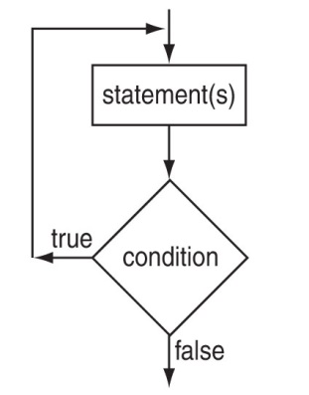
do-while Flow of Control

Slide 28
do-while Loop Notes
The loop body always executes at least once
Execution continues as long as the condition is true; the loop is exited when the condition becomes false
{ } are not required if the body contains a single statement
; after (condition) is required
Notes:
See pr5-10.cpp

Slide 29
do-while and Menu-Driven Programs
do-while can be used in a menu-driven program to bring the user back to the menu to make another choice
To simplify the processing of user input, use the toupper (‘to uppercase’) or tolower (‘to lowercase’) function. This allows you to check user input regardless of the case of the input. Note: requires cctype to be included.

Slide 30
Menu-Driven Program Example
do {
// code to display menu
// and perform actions
cout << "Another choice? (Y/N) ";
} while ((choice =='Y')||(choice=='y'));
The condition could be written as
(toupper(choice) == 'Y');
or as
(tolower(choice) == 'y');
Notes:
See pr5-11.cpp

Slide 31
5.8 The for Loop
It is a pretest loop that executes zero or more times
It is useful for a counter-controlled loop
Format:
for( initialization; test; update )
{ 1 or more statements;
}
Required ;
They don’t go here

Slide 32
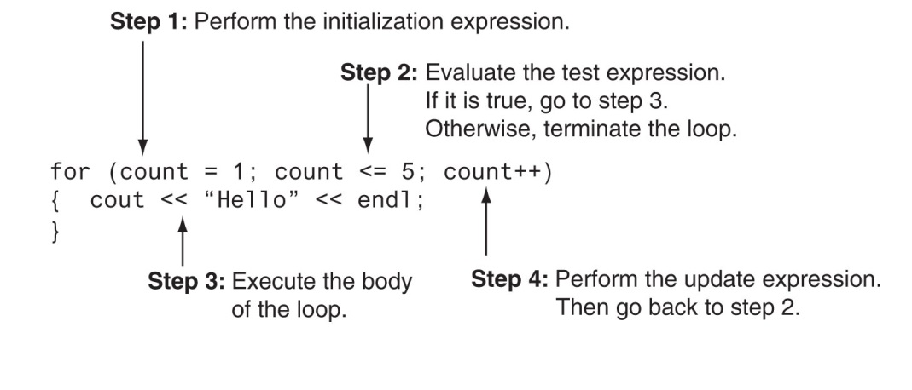
for Loop Mechanics

Slide 33
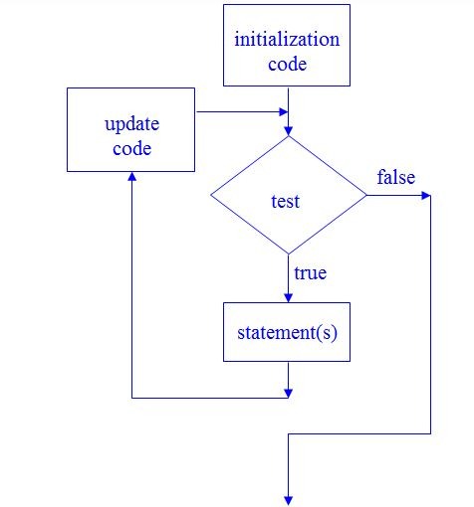
for Loop Flow of Control

Slide 34
for Loop Example
int sum = 0, num;
for (num = 1; num <= 10; num++)
sum += num;
cout << "Sum of numbers 1 – 10 is "
<< sum << endl;
Notes:
See pr5-12.cpp

Slide 35
for Loop Notes
If test is false the first time it is evaluated, the body of the loop will not be executed
The update expression can increment or decrement by any amount
Variables used in the initialization section should not be modified in the body of the loop

Slide 36
for Loop Modifications
You can define variables in initialization code
Their scope is the for loop
Initialization and update code can contain more than one statement
Separate the statements with commas
Example:
for (int sum = 0, num = 1; num <= 10; num++)
sum += num;

Slide 37
More for Loop Modifications (These are NOT Recommended)
Can omit initialization if already done
int sum = 0, num = 1;
for (; num <= 10; num++)
sum += num;
Can omit update if done in loop body
for (sum = 0, num = 1; num <= 10;)
sum += num++;
Can omit the loop body if all of the work is done in the header

Slide 38
5.9 Deciding Which Loop to Use
while: pretest loop (loop body may not be executed at all)
do-while: post test loop (loop body will always be executed at least once)
for: pretest loop (loop body may not be executed at all); has initialization and update code; is useful with counters or if precise number of iterations is known

Slide 39
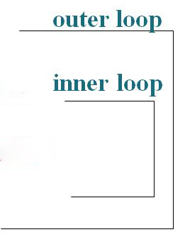
5.10 Nested Loops
A nested loop is a loop that is inside the body of another loop
Example:
for (row = 1; row <= 3; row++)
{
for (col = 1; col <= 3; col++)
{
cout << row * col << endl;
}
}
Notes:
See pr5-13.cpp

Slide 40
Notes on Nested Loops
The inner loop goes through all of its iterations for each iteration of the outer loop
The inner loop completes its iterations faster than the outer loop
The total number of iterations for inner loop is product of number of iterations of the two loops. In previous example, inner loop iterates 9 times in total.

Slide 41
5.11 Breaking Out of a Loop
break can be used to terminate the execution of a loop iteration
Use it sparingly if at all – it makes code harder to understand
When used in an inner loop, break terminates that loop only and returns to the outer loop
Notes:
See pr5-14.cpp

Slide 42
The continue Statement
You can use continue to go to the end of the loop and prepare for next iteration
while and do-while loops go to the test expression and repeat the loop if test is true
for loop goes to the update step, then test, and repeats the loop if test condition is true
Use continue sparingly – like break, it can make program logic hard to understand

Slide 43
5.12 Using Files for Data Storage
We can use a file instead of the computer screen for program output
Files are stored on secondary storage media, such as a disk
Files allow data to be retained between program executions
We can later use the file instead of a keyboard for program input

Slide 44
File Types
Text file – contains information encoded as text, such as letters, digits, and punctuation. It can be viewed with a text editor such as Notepad.
Binary file – contains binary (0s and 1s) information that has not been encoded as text. It cannot be viewed with a text editor.

Slide 45
File Access – Ways to Use the Data in a File
Sequential access – read the 1st piece of data, read the 2nd piece of data, …, read the last piece of data. To access the n-th piece of data, you have to retrieve the preceding (n-1) pieces first.
Random (direct) access – retrieve any piece of data directly, without the need to retrieve preceding data items.

Slide 46
What is Needed to Use Files
Include the ifstream and / or ofstream header file(s)
Define a file stream object
ifstream for input (read data) from a file
ifstream inFile;
ofstream for output (write data) to a file
ofstream outFile;

Slide 47
Open the File 1 of 2
Open the file
Use the open member function
inFile.open("inventory.dat");
outFile.open("report.txt");
The filename may include drive, path info.
The filename must include the full name, including extensions.
The output file will be created if necessary; an existing output file will be erased first
Input file must exist for open to work

Slide 48
Open the File 2 of 2
Creating a filestream object and opening a file can be accomplished in a single statement:
ifstream inFile("inventory.dat");
ofstream outFile("report.txt");
Again, input file must exist in order to be opened.
Output file will be created or erased as needed.

Slide 49
Use the File
Use the file
Can use output file object and << to send data to a file
outFile << "Inventory report";
Can use input file object and >> to copy data from the file to variables
inFile >> partNum;
inFile >> qtyInStock >> qtyOnOrder;
Notes:
See See pr5-15.cpp, pr5-16.cpp, and pr5-17.cpp

Slide 50
Close the File
Close the file
Use the close member function
inFile.close();
outFile.close();
Don’t wait for operating system to close files at program end
There may be limit on number of open files
There may be buffered output data waiting to be sent to a file that could be lost

Slide 51
Input File – the Read Position
Read Position – the location of the next piece of data in an input file
It is initially set to the first byte in the file
It advances for each data item that is read. Successive reads will retrieve successive data items.

Slide 52
User-Specified Filenames
A program can prompt the user to enter the names of input and/or output files. This makes the program more versatile.
Filenames can be read into string objects. In C++ prior to C++ 11, the C-string representation of the string object can be passed to the open function:
cout << "Which input file? ";
cin >> inputFileName;
inFile.open(inputFileName.c_str());
In C++ 11, the string object can be passed to the open() function directly.
Notes:
See pr5-18.cpp and pr5-19.cpp

Slide 53
Using the >> Operator to Test for End of File (EOF) on an Input File
The stream extraction operator (>>) returns a true or false value indicating if a read is successful
This can be tested to find the end of file since the read “fails” (the read expression is false) when there is no more data
Example:
while (inFile >> score)
sum += score;
Notes:
See pr5-19.cpp

Slide 54
File Open Errors
An error will occur if an attempt to open a file for input fails:
File does not exist
Filename is misspelled
File exists, but is in a different place
The file stream object is set to true if the open operation succeeded. It can be tested to see if the file can be used:
if (inFile)
{
// process data from file
}
else
cout << "Error on file open\n";
Notes:
See pr5-20.cpp

Slide 55
5.13 Creating Good Test Data
When testing a program, the quality of the test data is more important than the quantity.
Test data should show how different parts of the program execute
Test data should evaluate how program handles:
normal data
data that is at the limits the valid range
invalid data
Notes:
File pr5-21.cpp

Slide 56
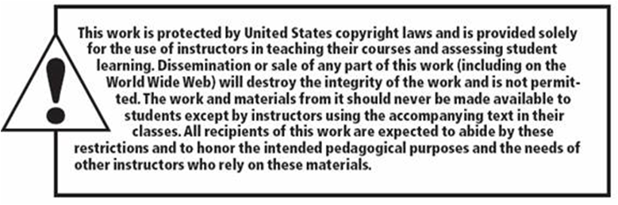
Copyright

